Slide 1

COVID-19
Covid Cases Globally according to World Health Organization Data

Slide 2
Content
Introduction
Objective
Problem Statement
Data analysis Dashboards

Slide 3
Introduction
COVID-19
COVID-19 is the disease caused by SARS-CoV-2, the coronavirus that emerged in December 2019.
COVID-19 can be severe, and has caused millions of deaths around the world as well as lasting health problems in some who have survived the illness.
The coronavirus can be spread from person to person. It is diagnosed with a laboratory test.
COVID-19 vaccines have been authorized for emergency use by the U.S. Food and Drug Administration, and vaccination programs are in progress across the U.S. and in many parts of the world

Slide 4
Objective
Data is about Covid-19 in all regions Globally
Data shows that cases,deaths,activecases, Reported cases
Reported active cases and Death cases internationally
The Data I downloaded from the website WHO website
Data is taken from various regions and various countries

Slide 5
Problem Statement
What are the total number of Confirmed cases in different nations?
What are the total number of Confirmed cases in India?
What are the total number of Recovered cases in India?
Can we Forecast Trend-Line for COVID - 19?
Find the Higest Death rates Internationally?
Can we forecast the sheet for future and reference?

Slide 6
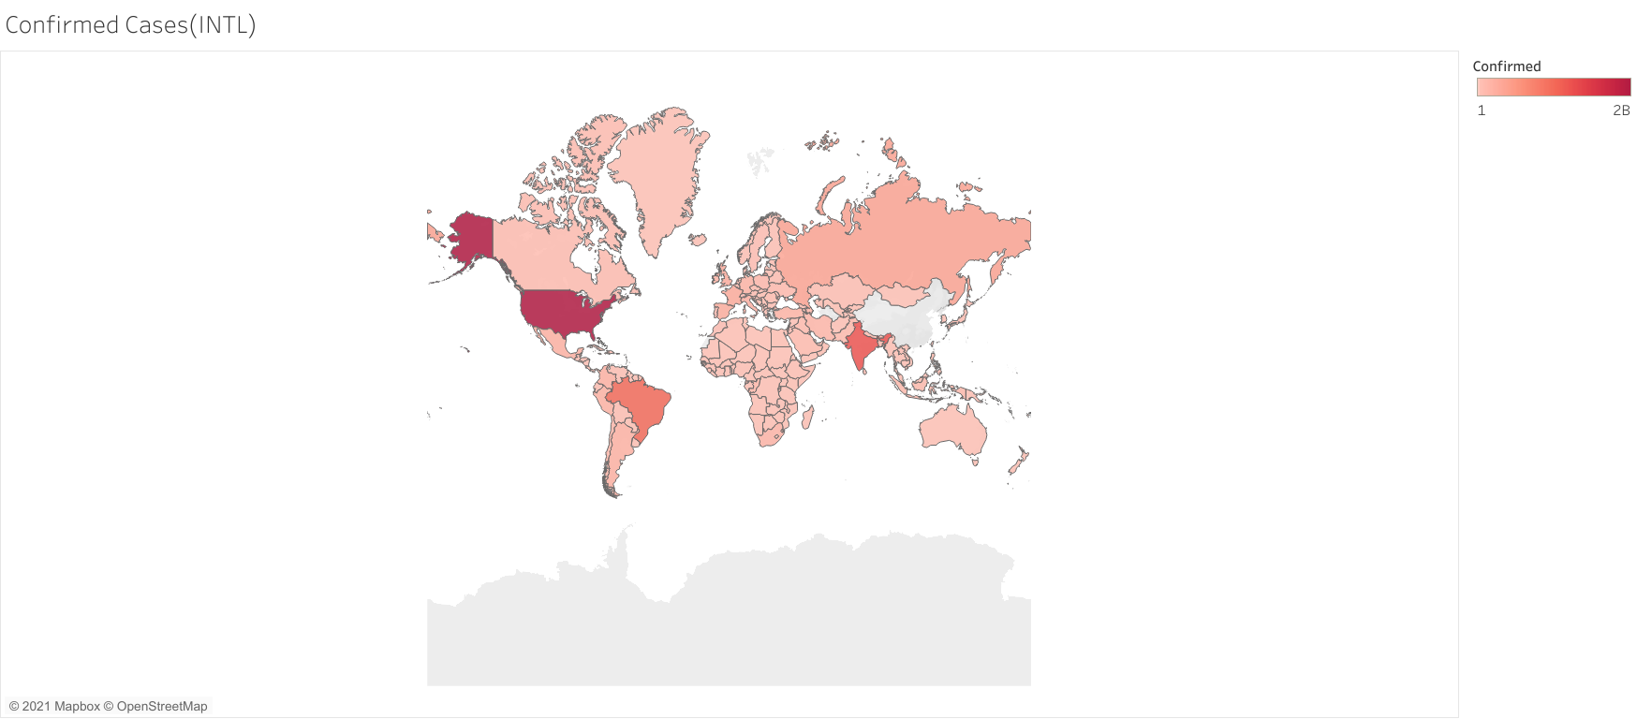

Slide 7
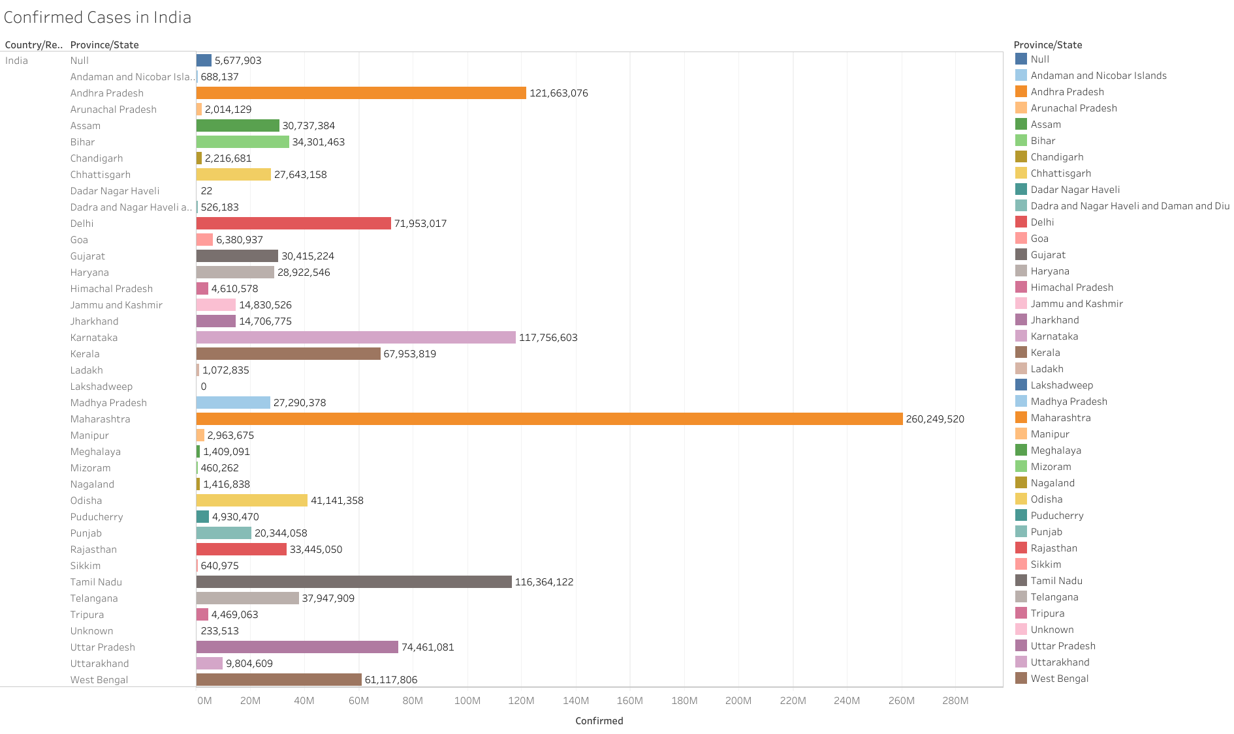

Slide 8
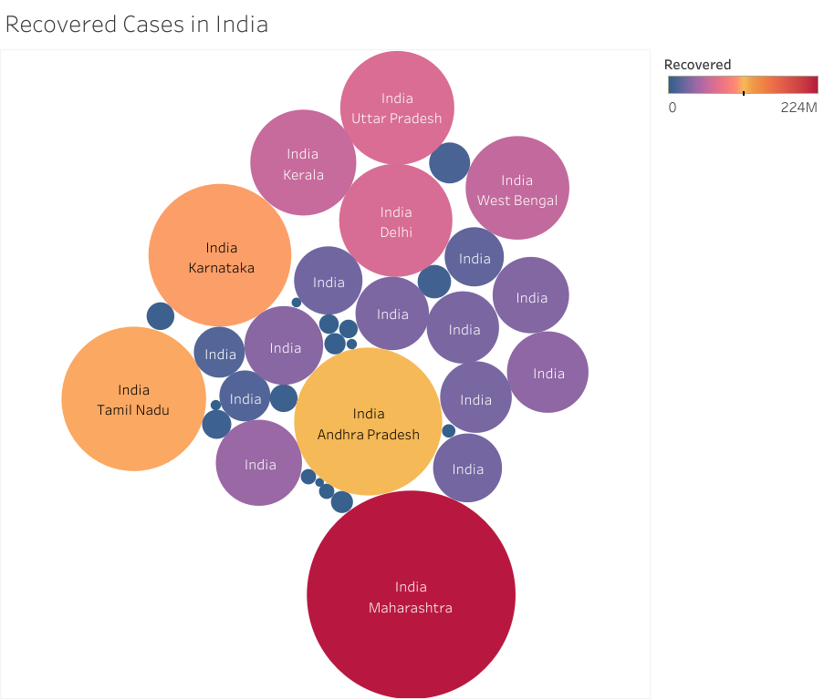

Slide 9
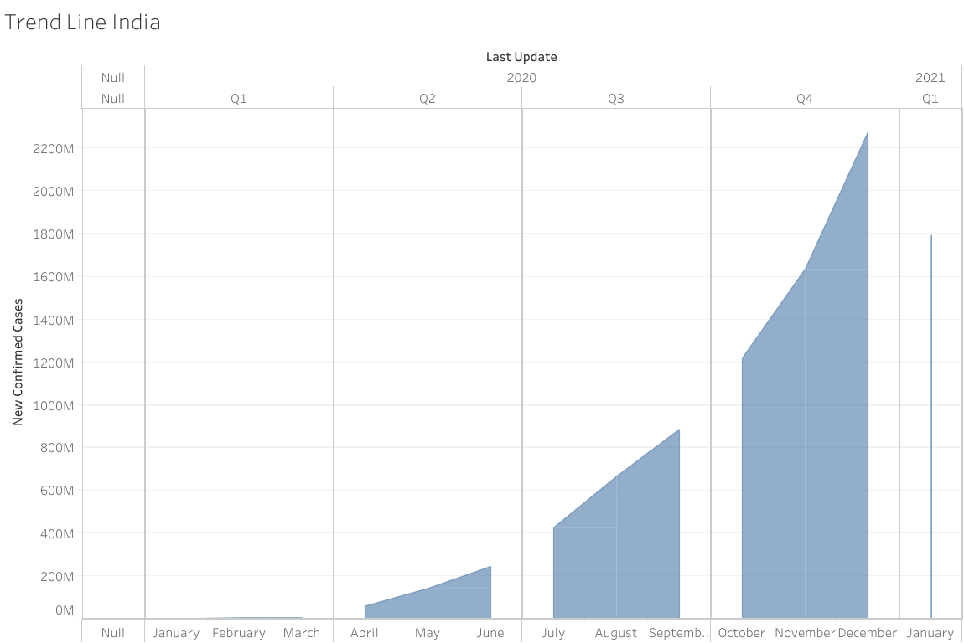

Slide 10
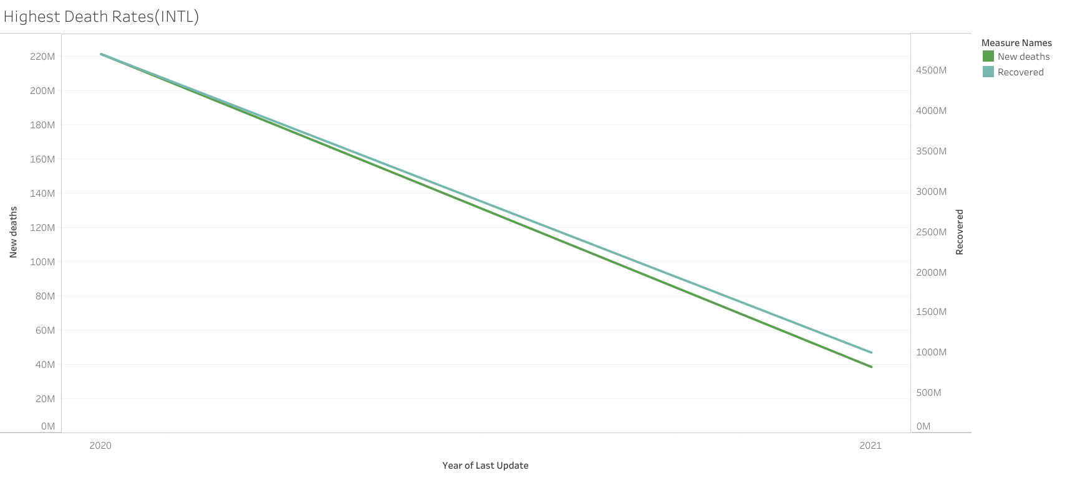

Slide 11
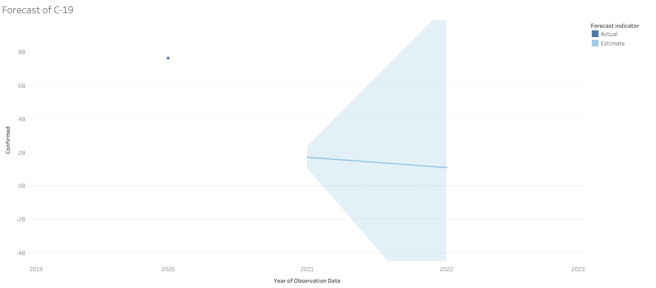

Slide 12
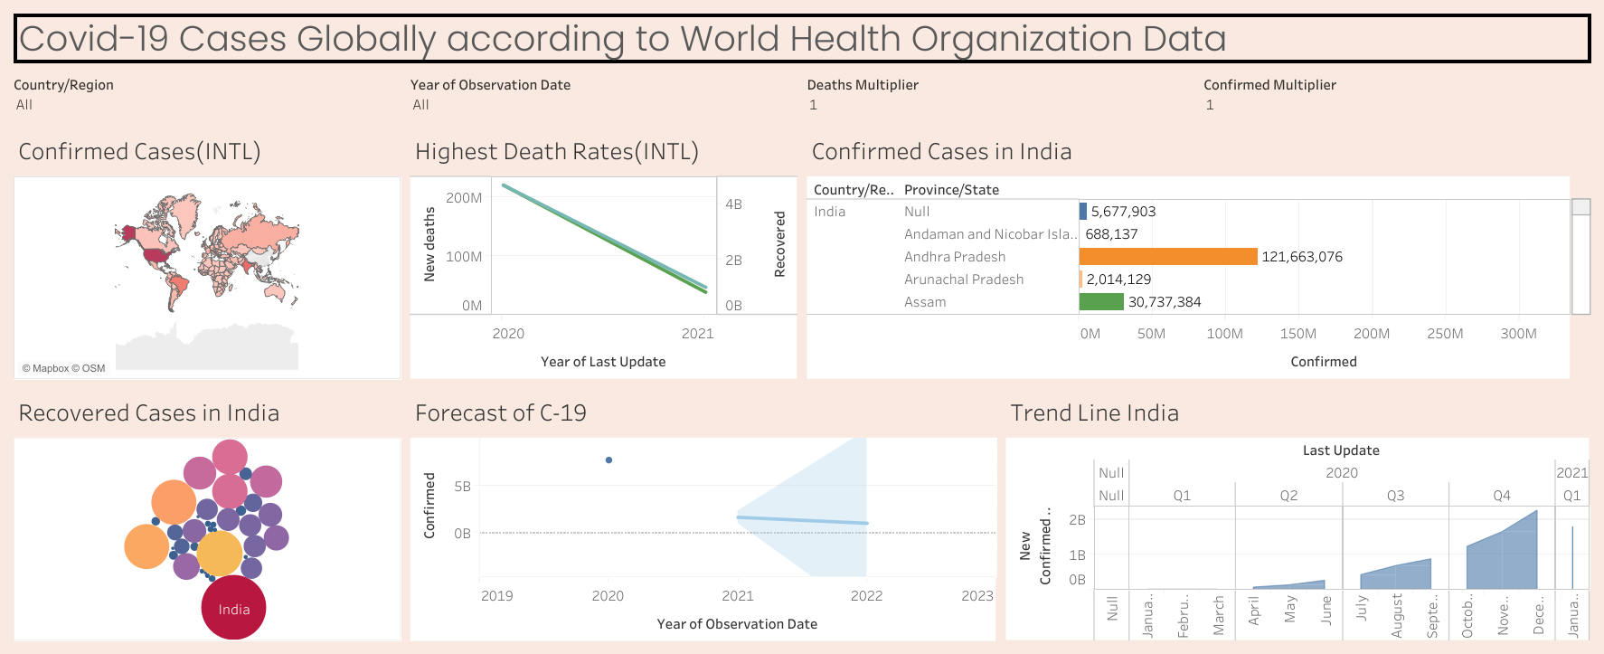
DashBoard

